Slide 1

Mobilization, Persuasion, and the Partisan Fallout of the Gender Gap in U.S. Voting
Barry C. Burden
Michael DeCrescenzo
University of Wisconsin-Madison
Department of Political Science

Slide 2
Vote Choices of Men and Women
Notes:
ANES – 16 elections

Slide 3
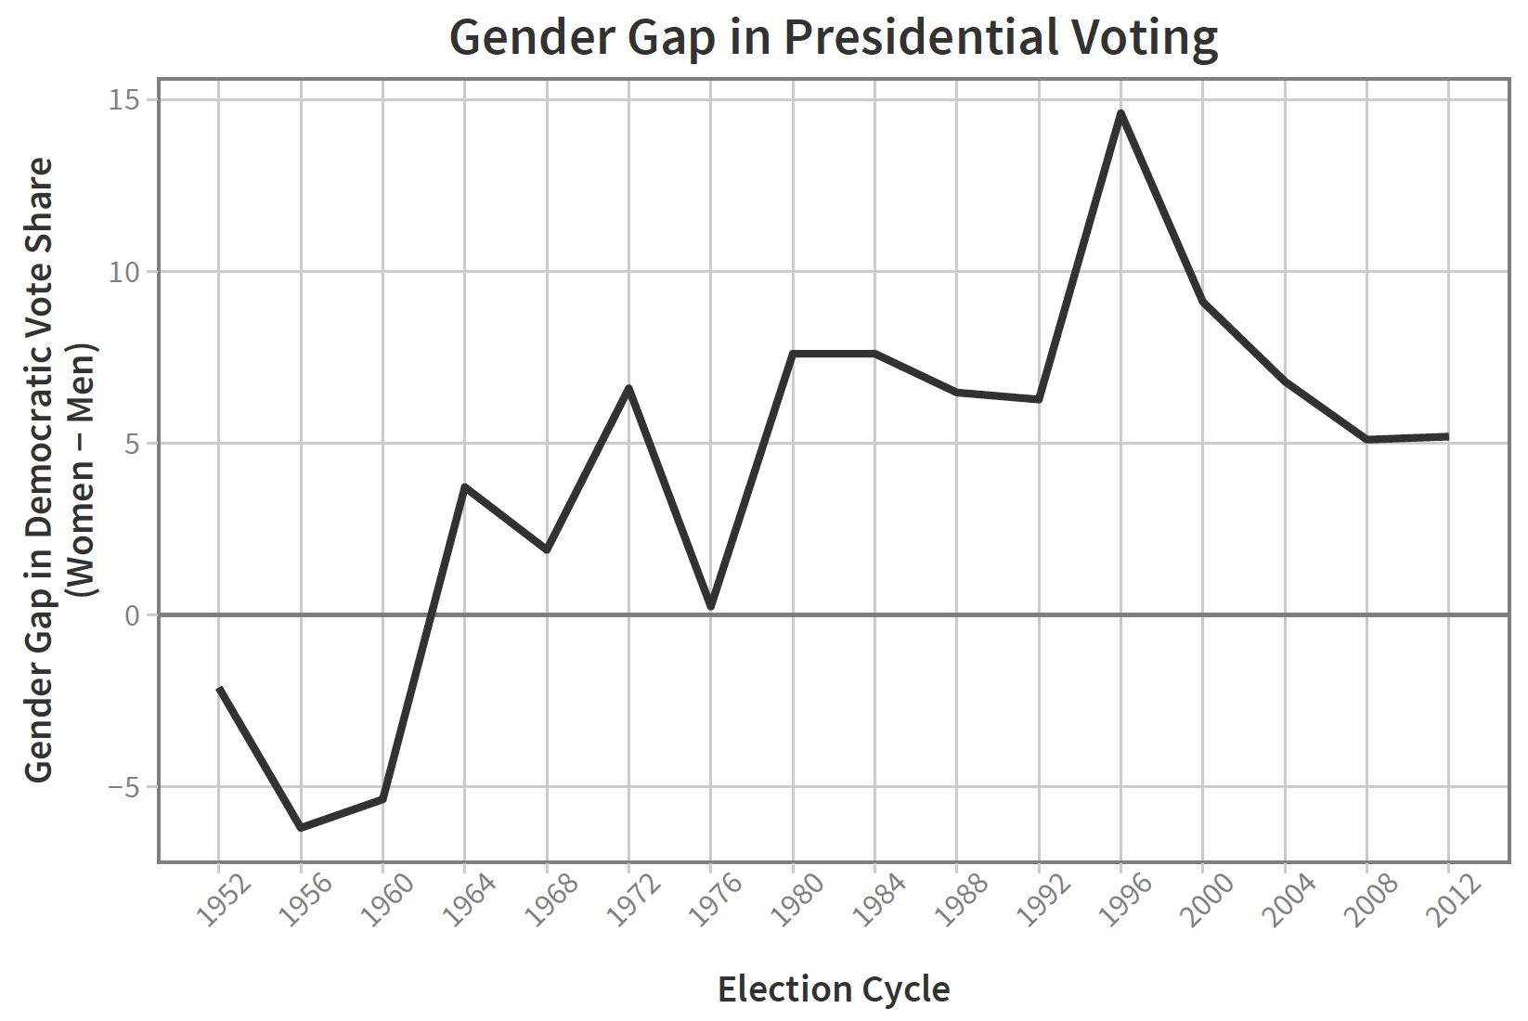
The Gender Gap in Voting
Notes:
First noticed in 1980
Lit attributes to policy preferences, women’s independence, feminism, socialization

Slide 4
Conventional Wisdom
“The Republicans are on the defensive partly because the gender gap – in which Democrats have a sizable advantage among women – is growing.” (Washington Post October 7, 2012)
Democrats’ focus on women “generated a gender gap and has been crucial to past Democratic victories.” (New York Times November 5, 2014)
“You know the Democrats are in big trouble when the media starts harping on the gender gap.” (USA Today November 5, 2012)

Slide 5
Trends in Partisanship
Notes:
ANES – “leaners” coded as partisanship

Slide 6
Turnout by Gender

Slide 7
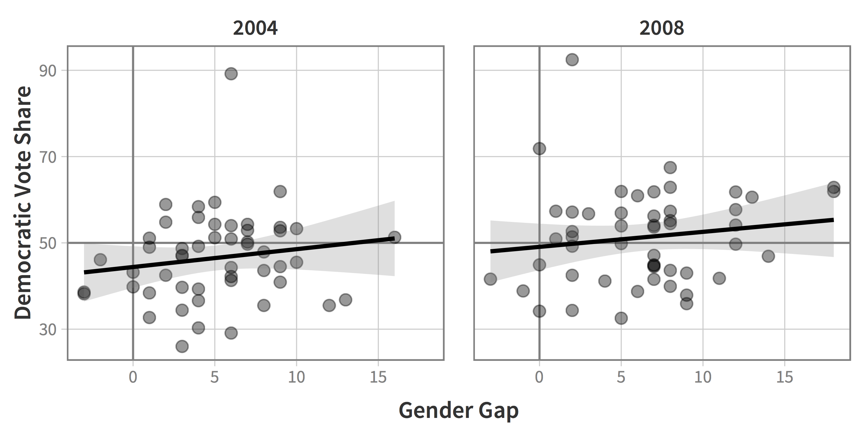
Cross-Sectional Test
Notes:
r = .16 (2004)
r = .14 (2008)

Slide 8
Longitudinal Test
Notes:
16 presidential elections from ANES
Will be data for rest of paper
r = .17

Slide 9
A Theory of Electoral Gaps
No necessary relationship between gap and vote share
Gap itself does not convey enough information
3 factors to consider:
partisan predispositions of group members
mobilization of party supporters in each group
persuasion of party supporters in each group
Notes:
General enough to be applied to any groups

Slide 10
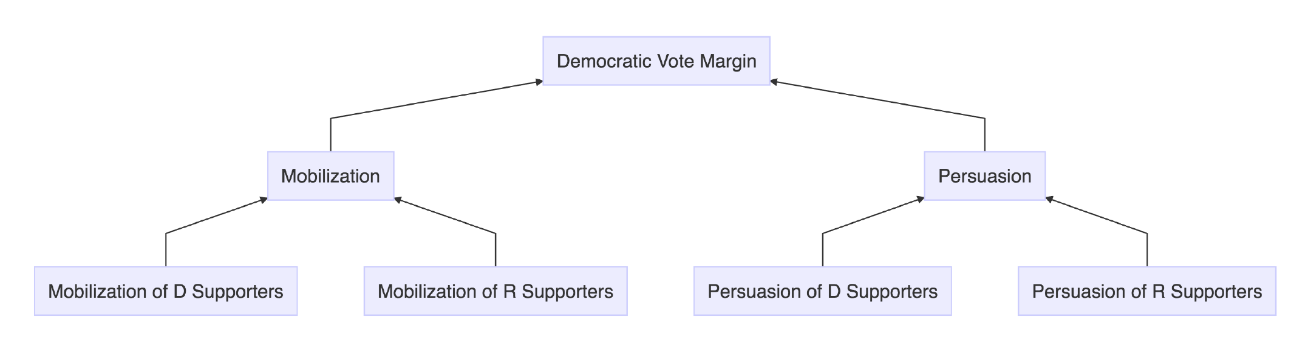
How Partisanship Translates to Votes
Mechanisms: mobilization and persuasion
Notes:
Think of as short-term campaign effects on long-term base

Slide 11
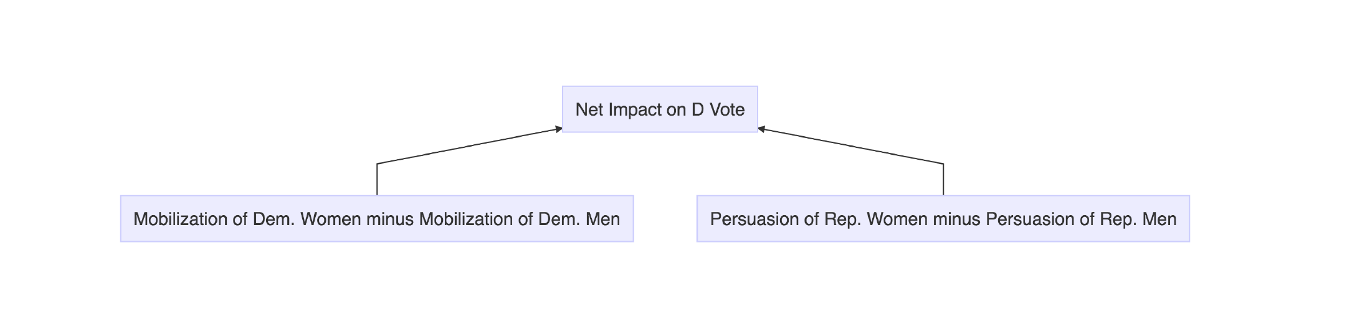
Net Differences Most Important
Must measure as raw numbers not rates
Note: persuasion effect twice that of mobilization
Notes:
Effects can vary by election – not timeless

Slide 12
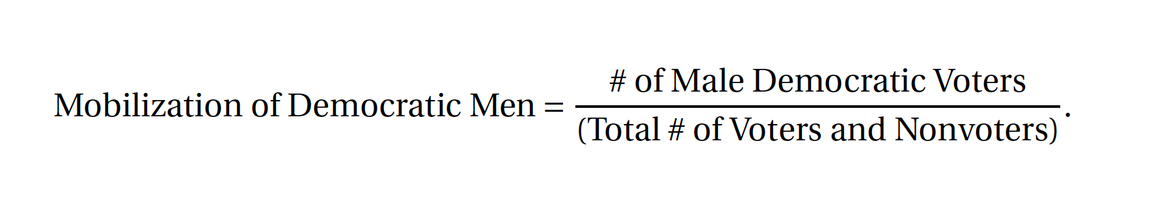
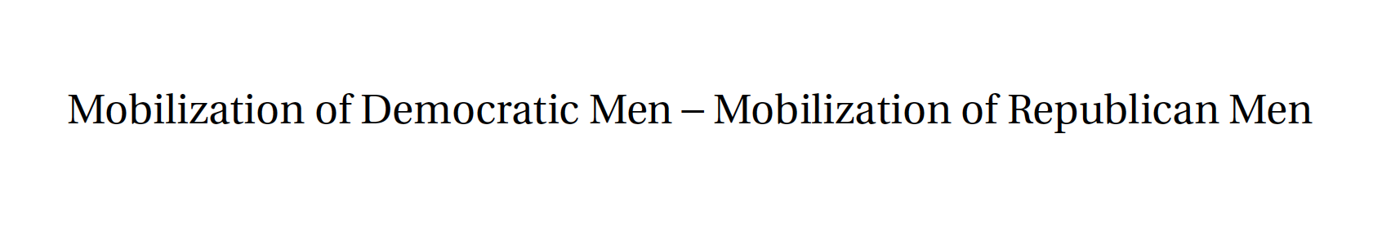
Measuring Net Mobilization
Net Democratic advantage in turnout:
Notes:
Do the same for persuasion
16 pres elections in ANES (1952-2012)
Measure partisanship using party ID in 2 ways to account for debate about leaners

Slide 13
The Measures
Notes:
Mobilization: Weakening Democratic advantage among men
Mobilization: Roughly constant Democratic advantage among women
Persuasion: Generally advantages the Democrats
Not all mobilized partisans are voting loyally, but this gets “corrected” in a sense by the measurement of persuasion.

Slide 14
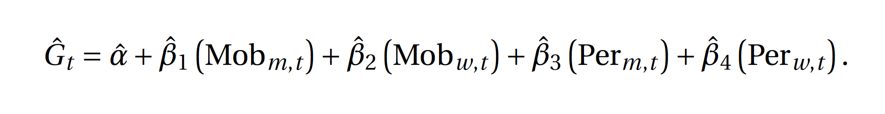
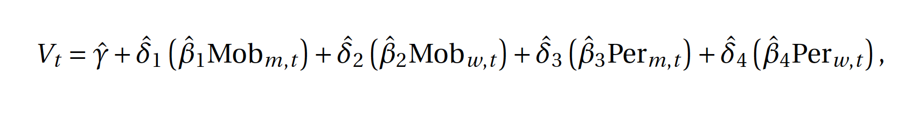
A Two-Stage Model
Stage 1: Gender Gap
Stage 2: Vote Shares
Notes:
Like TSLS or SEM
What this means:
To the extent that some predictor is related to the gender gap (as captured by the stage-1 beta)
Here’s what that means for the overall Democratic vote (captured by delta)

Slide 15
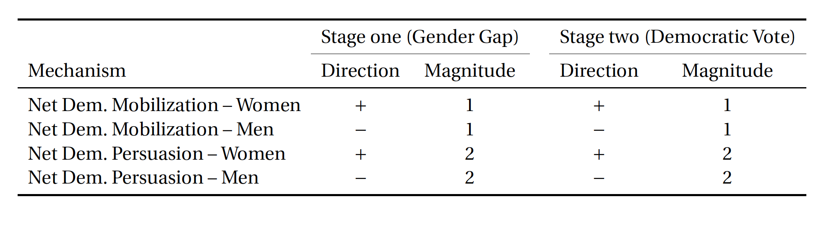
Expectations
Notes:
Predictors are positive when Ds net more votes from the predictor than Rs do
More votes from Women drive up both the gender gap and the Dem vote, intuitively
But when Ds net more votes from men, this actually drives the gender gap down, all else equal, because it means more men are casting D votes.
Stage 2:
Women in stage 1 grow the Gap by giving Ds more votes, so it makes sense that stage 2 coef is +
When Ds net votes from men, stage 1 effect is negative. More Dem votes, negative effect on the gender gap.
This means: when we are in stage 2, when mechanisms among men drive the gap up, hence marginal increases in the gender gap, the number of votes for Ds goes down. So stage 2 coefs for men are negative as well
Say something about the magnitude column?

Slide 16
Regression Results
Notes:
Coefficients follow the intuition.
All significant in stage 1.
Not as many significant coefficients in stage 2, but as we will see, the model fits very well.
Say something about magnitude?

Slide 17
Gender Gap Effects (Stage 1)
Notes:
Mobilization (column 1):
Women’s mobilization is noisy but centered around a fairly constant average over time. It contributes a noisy but fairly stable component to the gender gap.
Democrats experience a humongous decay of mobilization among men over the same time period.
Total mobilization (column 2) is the sum of women’s and men’s mobilization. When added together, it is the mobilization changes among men that contribute most heavily to mobilization’s overall contribution to the gender gap.
Persuasion (col 3):
From the predictors alone, we see that persuasion among men and women are fairly equal over time, so men and women as a result have mutually annihilating impact on the gender gap.
When men and women defect at roughly the same rate, the gender gap isn’t affected all that much.
(column 4):
Persuasion had a small impact on the gender gap in past decades, but as persuasion disappears from the electorate with the rise of hyper-partisan voting, persuasion’s impact on the gender gap disappears toward zero.
Total campaign: if we add all of these constituent mechanisms together, we get the total effect of these four mechanisms on the gender gap.
We see that the “total campaign” effect appears to be mostly driven by changes in mobilization, judging from the similarity of the figures in column 2 and in the right-most column.
(Next)

Slide 18
Predicted and Observed Gender Gap
Notes:
And as we see, the predicted gender gap mirrors the observed gap very closely.
R^2 between .85 and .95
We see how well the stage-one model performs
The regression model is almost an accounting identity for the Democratic vote. The Democratic vote margin literally is the sum of partisan mobilization and persuasion.
Not perfect because we exclude independents (depending on the coding)

Slide 19
Vote Effects (Stage 2 via Stage 1)
Notes:
Mobilization:
Men: remember that mobilization is decreasing in its D advantage over this time period. So we’re seeing a declining Democratic advantage due to mobilization.
This is occurring due to the same process by which the gender gap increases, which is lower mobilization of male Democrats relative to male Republicans.
Conventional wisdom is that the larger the gender gap, the better the Democrats do. If we parse out the effect of mobilization only, we show that the opposite effect is happening. The gender gap is growing over this period due to changing party advantage in mobilization, but this is associated with a declining advantage for the Democrats. Bigger gender gap, fewer Democratic votes.
Persuasion, overall, this has harmed the Democratic vote over time.
Recall from stage 1 however that persuasion grew the gender gap in the past, but no longer has any impact because persuasion basically disappears.
We’re finding here that persuasion’s impact on the gender gap meant fewer Democratic votes in the past, but the detriment to D candidates gets zereod out in the 90s and 2000s.
Conventional wisdom, again, bigger gender gap, more D votes. We’re again finding the opposite. Persuasion increased the gender gap in the past, but it hurt the Democrats because it was coming from stronger persuasion effects among Republican men.
As this influence on the gap has shrunk over time, this means that Democrats are showing up their base of support. No longer are men defecting as much, so the shrinking gap due to persuasion actually is good for Democrats.

Slide 20
Predicted and Observed Dem. Vote
Notes:
Again, the model is *accurate*insofar as it produces an accurate left-hand side prediction.
Remember, this isn’t so much a causal model of the vote. It’s more like an accounting identity.

Slide 21
Reiterating the Findings
Gender gap has grown but Democratic vote share has not
Men’s mobilization has much bigger effect than women’s mobilization
Persuasion benefits Republicans but has declined
Changes in mobilization and persuasion actually weakened relationship between gender gap and the vote
Notes:
Topline: no strong relationship
Break out into mechanisms, each appears to have had counter-intuitive relation between gender gap and D vote

Slide 22
Conclusions
Little support for conventional wisdom – depends on why gender gap exists
Gender gap measures vote choices that are product of multiple forces
Theory and measurement of electoral gaps, focused on mobilization and persuasion, widely applicable

Slide 23
Mobilization, Persuasion, and the Partisan Fallout of the Gender Gap in U.S. Voting
Barry C. Burden
Michael DeCrescenzo
University of Wisconsin-Madison
Department of Political Science

